Slide 1
Bank DATA analysis
Data Mining project – University of South Florida
YouTube presentation link - https://www.youtube.com/watch?v=f0rDacQQKhY&feature=youtu.be
Team Lead:
Pankaj Kumar
Team Members:
Manaswini Reddy
Praveen Dharmalingam
Harshavardhan Reddy

Slide 2
Contents
Introduction and Objective
Dataset description
Data cleaning
Data Visualization using Tableau
Data modeling using SAS Enterprise Miner
Inferences
Conclusion
References

Slide 3
Reason to take up a bank data set
Banking/Finance is one of the most critical sectors which involves a lot of transactions per minute worldwide. It is a pressing need to maintain integrity in data as a small margin of error also would lead to a loss of monetary value either for the bank or for the customer.

Slide 4
Objective
To predict if the bank customers will subscribe for a term deposit.
To evaluate how many customers have responded to a marketing campaign by taking a loan.

Slide 5
Dataset overview
Source : Kaggle
https://archive.ics.uci.edu/ml/datasets/bank+marketing
Total Observations – 45211
Total Fields – 17
17 variables
Categorical – 6
Numeric- 7
Binary-4

Slide 6
Dataset overview
2 Target Variable
Term_deposit : binary
Poutcome: categorical

Slide 7
Data fields
Attribute | Description
Age | Age of the customer
Job | Job of the customer
Marital_Status | Marital status of the customer
Education | Educational level of the customer
Default_Credit | If the customer has credit by default?
Avg_yearly_Balance | The yearly average balance of the customer in Euros
House_Loan | If the customer has housing loan?
Personal_Loan | If the customer has personal loan?
Contact_Type | communication type of the customer
Contact_Day | Last contact day of the customer
Contact_Month | last contact month of the customer
Duration | last contact duration in Seconds
Campaign | Number of contacts performed during this campaign and for this client
Past_Days | Number of days that has passed by after the client was last contacted from a previous campaign
Previous | Number of contacts performed before this campaign for this client
POutcome | Outcome of the previous marketing campaign
Term_Deposit | If the customer has subscribed to a term deposit?

Slide 8
Data preparation
Missing values:
Missing values were imputed.
Replace Missing Values Operator – SAS Enterprise Miner
Numeric Values – Average
Categorical Values – Median
Under Sampling
The data is highly skewed with 95% of the data where the target variable term_deposit =no
Therefore, we randomly selected rows with 50% of them having term_deposit=yes and the remaining 50% of them having term_deposit=no.

Slide 9
Data preparation
Converting categorical values into nominal values or binary values.
Removed rows where more than 60% of values were unknown

Slide 10
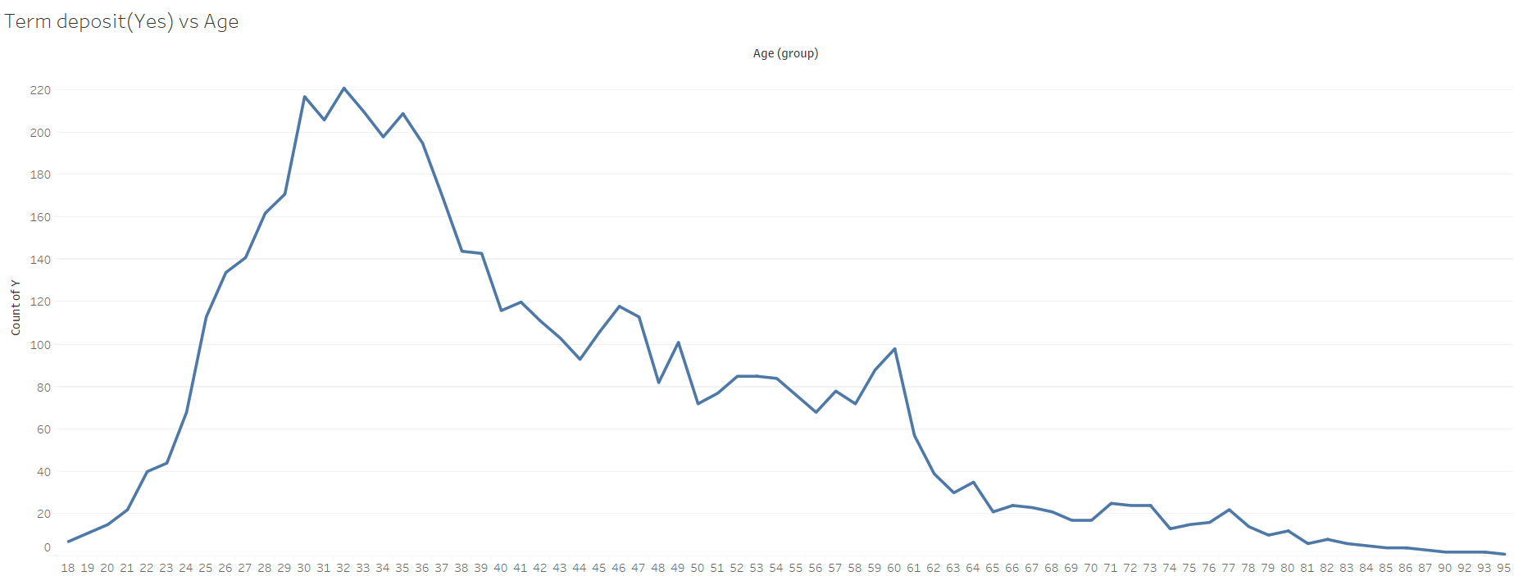
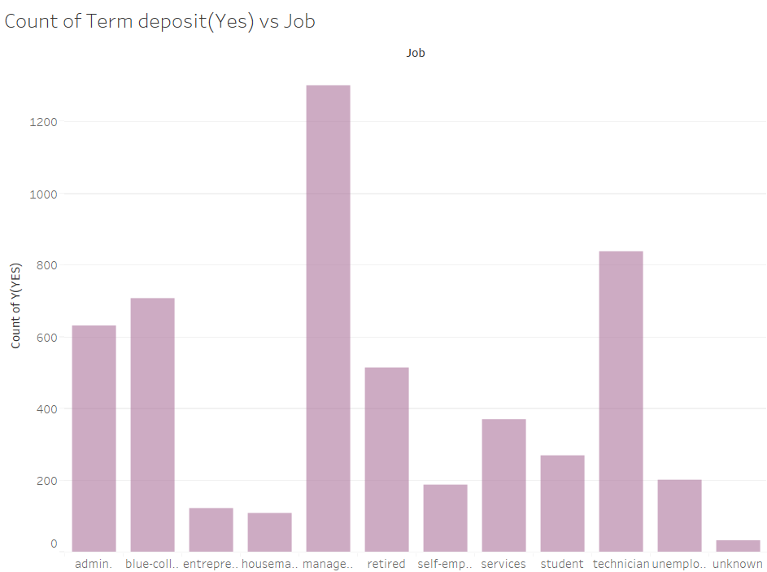

Data visualization using TABLEAU

Slide 11
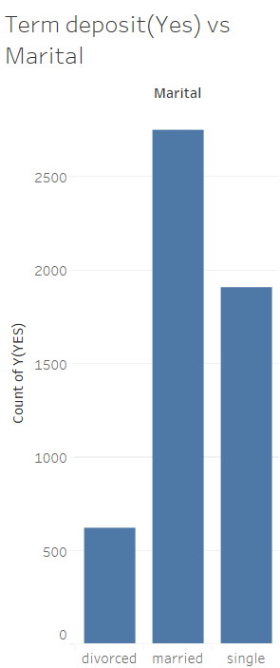
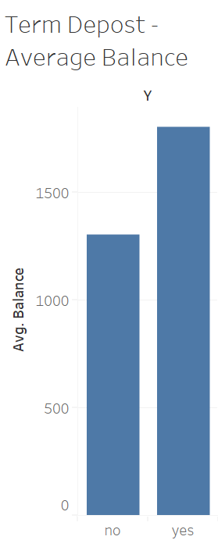
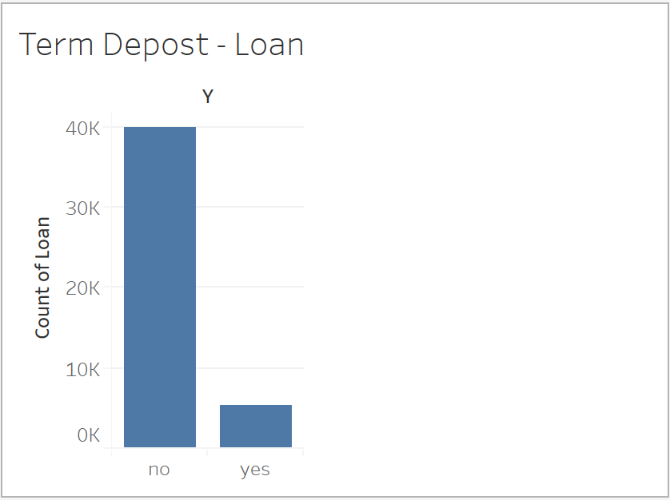
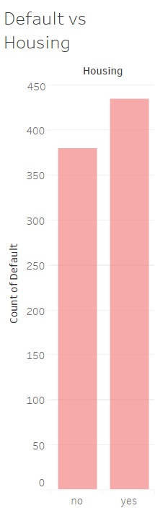

Data visualization USING TABLEAU

Slide 12
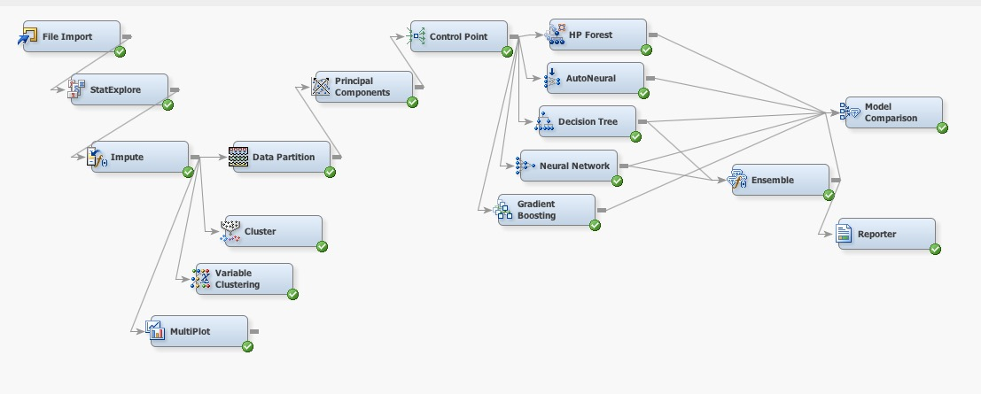
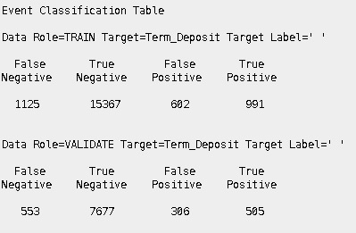
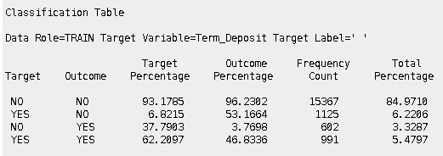
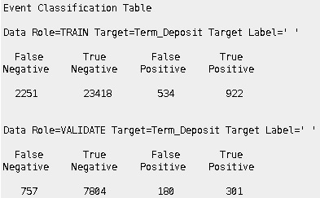
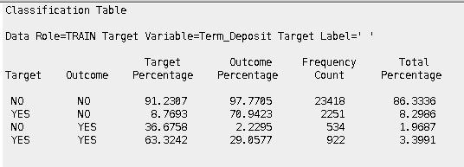
Data modelling 1: Term deposit as target variable
Decision Tree
Neural Network

Slide 13
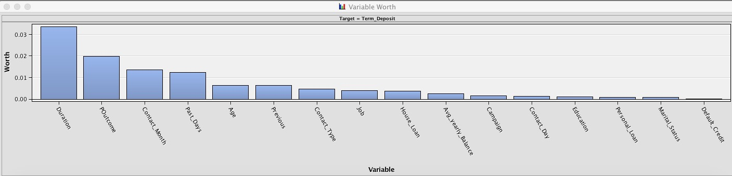
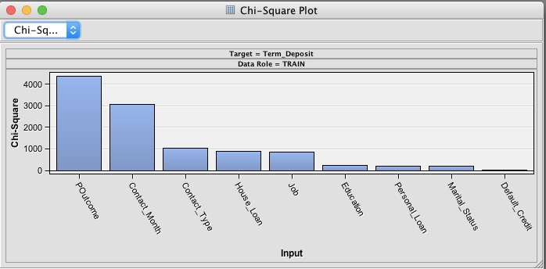
STAT Explorer- Variable worth for predicting TARGET VARIABLE

Slide 14
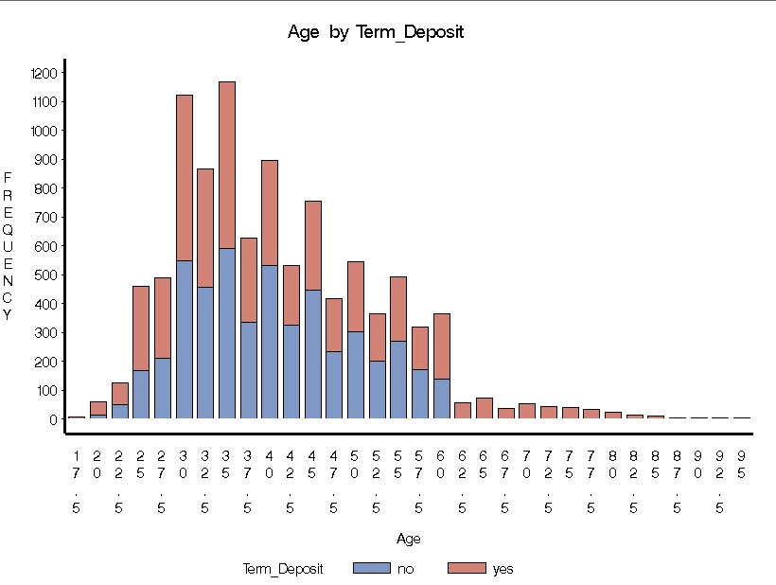
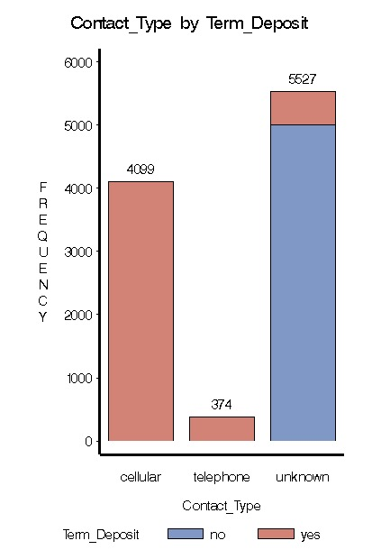
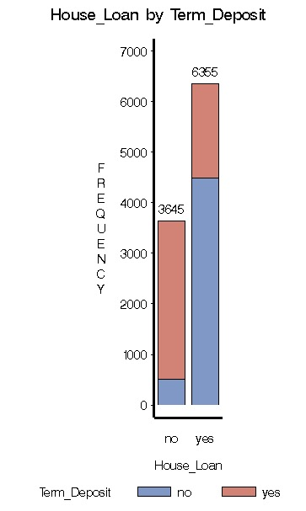
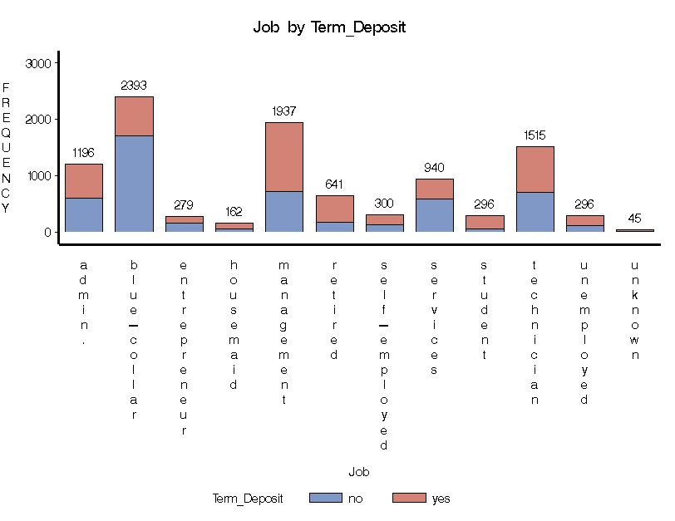
Graphs from Multiplot:

Slide 15
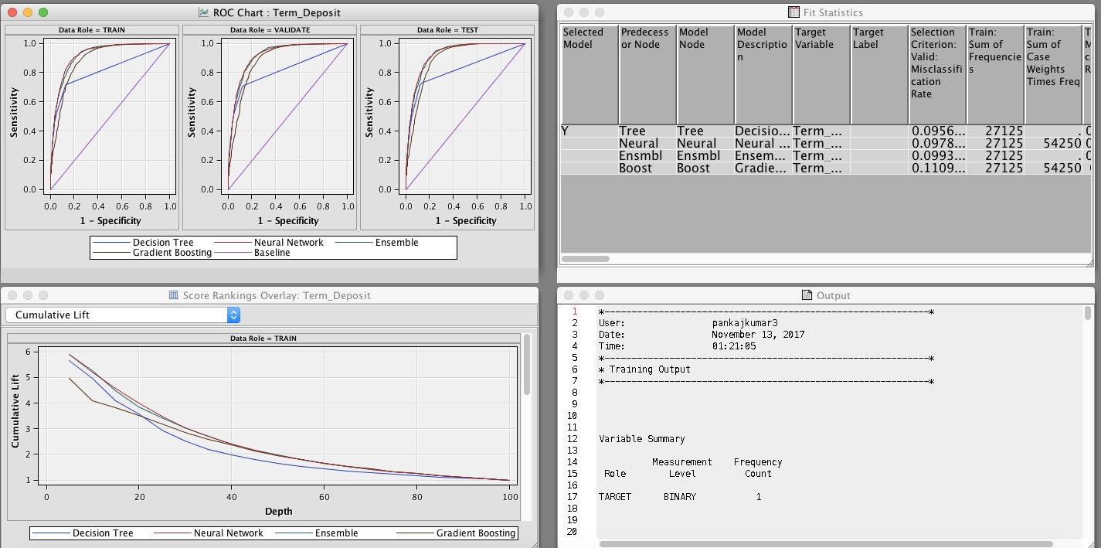
Inference
Using the model comparator Decision tree was the best model among all the others
Overall accuracy is high
As the data is highly skewed we also need to look at the confusion matrix
From our observations, we found that false negative was very high and true positive was low. So, we took 50-50% approach in our next enhancement model.

Slide 16
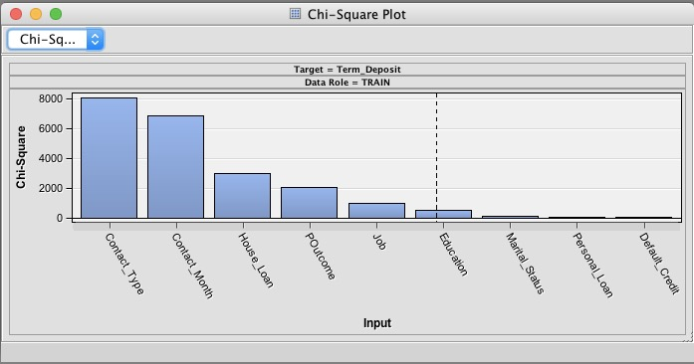
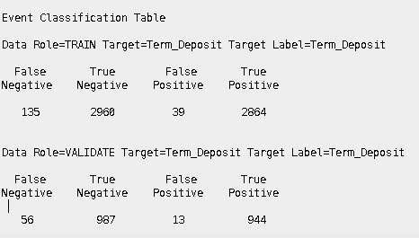
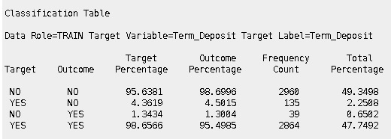
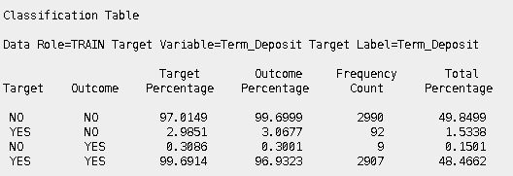
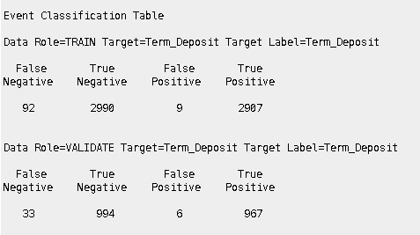
Enhancement model 1 – 50-50 approach
Decision Tree
Ensembler

Slide 17
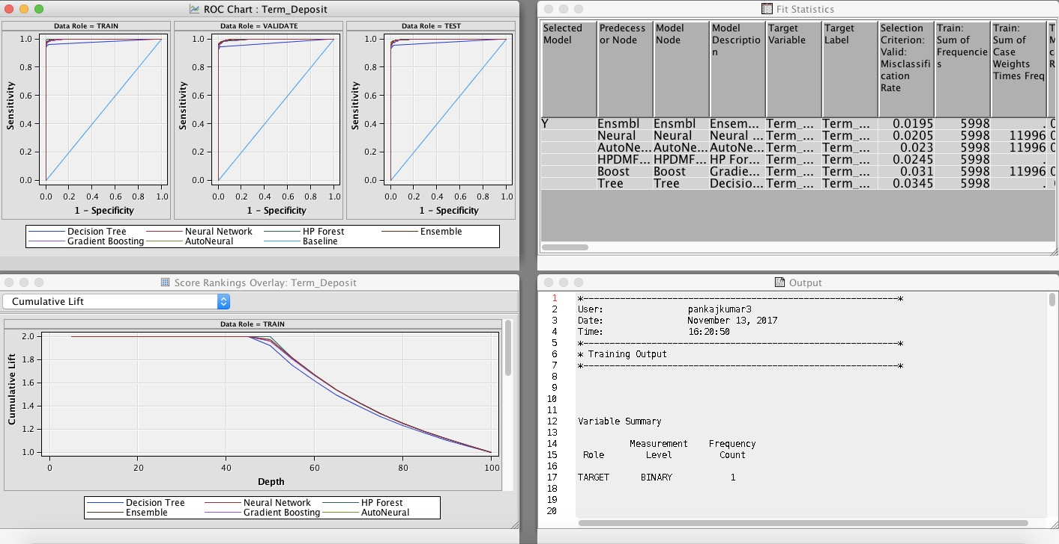
Inference
Using the model comparator, Ensemble model which was derived from decision tree and neural network, was the best model among all the others
Overall accuracy is high.
From our observations, we found that false negative decreased and true positive rate increased at high rate. So, to verify our outcome, we took 33-66% approach in our next enhancement model.

Slide 18
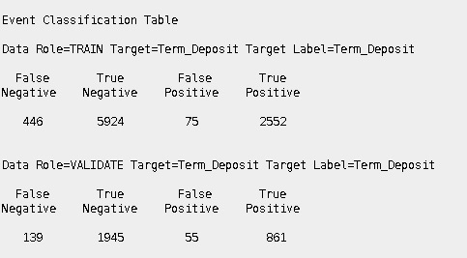
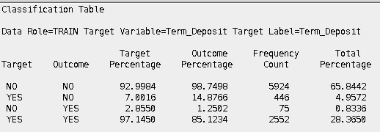
Enhancement model 2 – 33-66 approach
Decision Tree

Slide 19
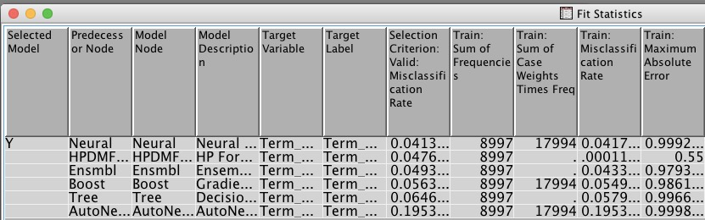
inference
Using the model comparator, neural network was found to be the best model among all the others.
Overall accuracy is high.
From our observations of confusion matrix, we found satisfactory values for false negative and true positive rate.
Model comparator

Slide 20
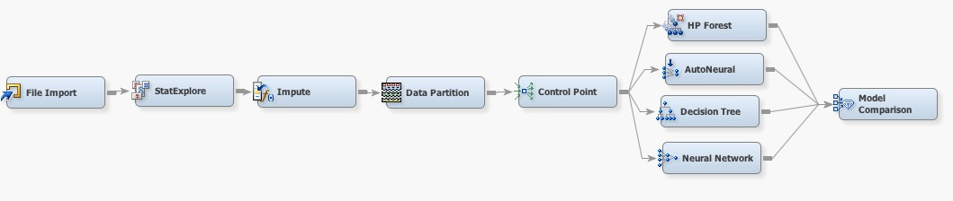
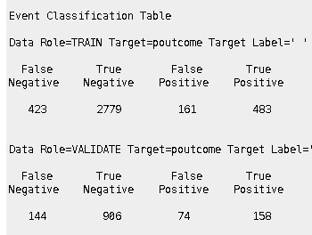
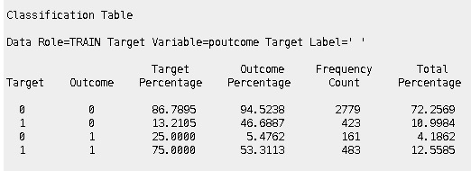
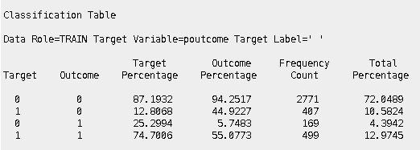
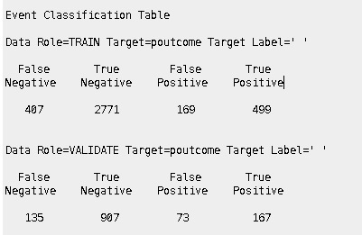
Data modelling 2: Poutcome as the target variable
Decision tree
Random Forest

Slide 21
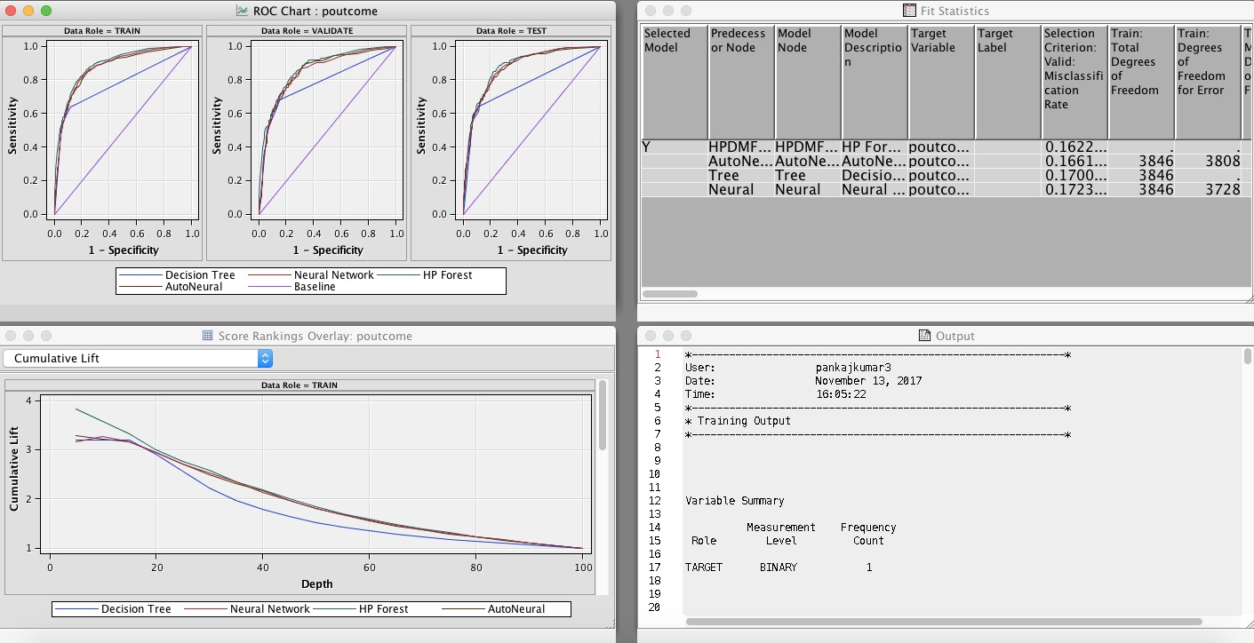
Inference
Using the model comparator, Random Forest model with a misclassification rate of 16.22% was the best among all the others

Slide 22
Conclusion
From the analysis of Data Model 1, a prediction can be made to know if the customers are going to make a term deposit or not which will help the bank improve its revenue which in turn adds to the business value.
From the analysis of Data Model 2, we can predict if a customer responds to a certain marketing campaign which can be used to target a specific customer base for future campaigns and save marketing expenditure.

Slide 23
References
http://support.sas.com/documentation/cdl/en/emgsj/66018/HTML/default/viewer.htm#n1docbb4hkr3nwn1ukqzqmme48yn.htm
http://support.sas.com/documentation/cdl/en/stathpug/68163/HTML/default/viewer.htm#stathpug_hpsplit_details01.htm
http://support.sas.com/documentation/cdl/en/emgsj/64144/HTML/default/viewer.htm#p03iy98sk0c9bvn1r6x7ppx8uj08.htm
http://support.sas.com/documentation/cdl/en/prochp/67530/HTML/default/viewer.htm#prochp_hpimpute_syntax05.htm
https://www.mwsug.org/proceedings/2016/AA/MWSUG-2016-AA20.pdf

Slide 24
Thank you
THANK YOU

